Slide 1
Fundamentals of Testing

Slide 2
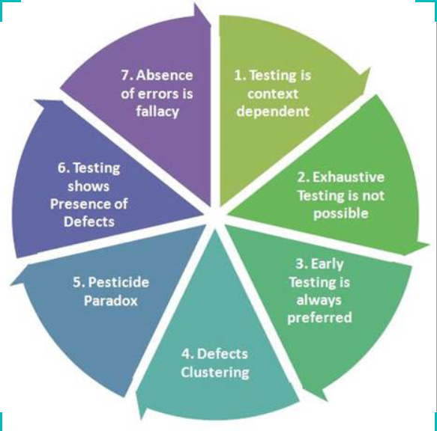
What is testing ?
Challenging user requirement
Why testing is necessary
To Prevent loss of Money, Reputation, Injury, Death..
What is Software Testing→ Last line of defence
Objective of testing→ a. Finding defects b. Gaining confidence on level of testing c. Information for decision making d. Preventing defects
Defect Terminology→ Error, Mistake, Defect, Fault, Bug, Failure, Quality, Risk
Fundamentals of Testing
Software testing Principles

Slide 3
Causes of Software Defects→ a. Human being can make errors in documents, code, design, testing b. Time pressure, Complex code, Infrastructure.. c. Radiation, magnetism, electronic fields… d. Environmental
What is Quality Control
Controlling / validating the quality of the project outputs
What is Quality Assurance
Assuring the appropriate processes are being employed on the project based on the quality control results
International Standards→ IEEE 829-1998, IEEE Standard for Software test documentation
IEEE 1028-2008, IEEE Standard for Software for Software reviews and Audits
IEEE 12207, Software life cycle process
ISO 9126- Software Engineering-Software Product Quality
IEC stands for International Electrotechnical Commission
Fundamentals of Testing

Slide 4
Software Development Models
  Predictive
  Iterative incremental Model
  Adaptive
Approaches
a).Scrum
b).Extreme Programming
c).Lean
d).Kanban
e).Crystal
f).Feature-Driven Development (FDD)
g).Dynamic Systems Development

Slide 5
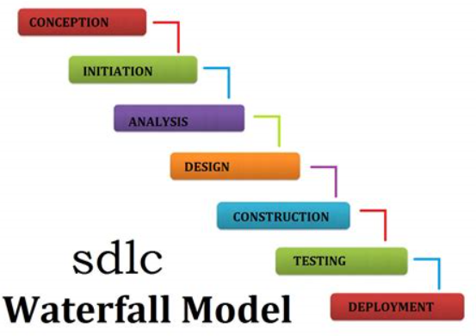
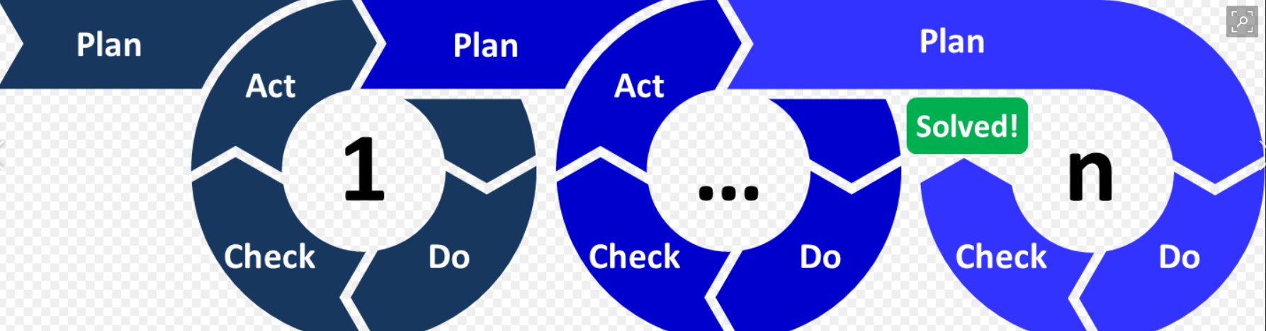
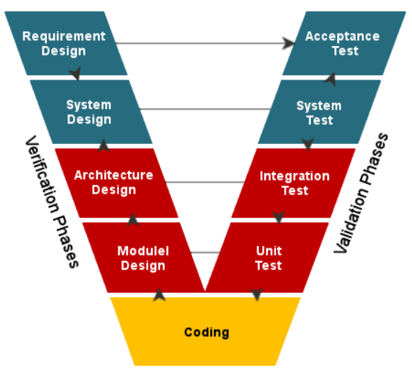
Process Models
Agile
Empirical process
Inspect & Adapt
Deliver to objective
Waterfall
Defined Process
Predict & Control
Deliver to plan
V-Model
Defined Process
Predict & Control
Deliver to plan

Slide 6
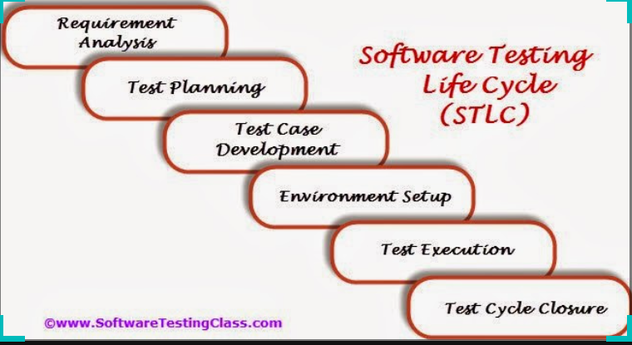
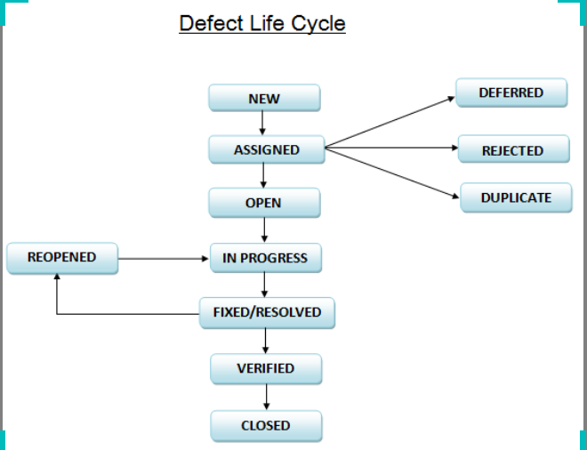
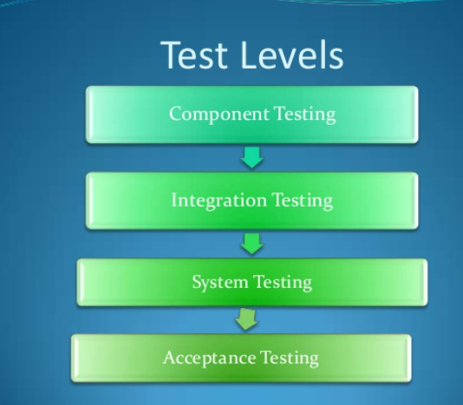
STLC
Component Testing→ Components, Programs, Migration, Database Models..
Integration Testing→ Subsystems, Interfaces, Infrastructure..
System Testing→ Completes System, Users, Operations..
Acceptance Testing→ Business Process, User procedures..

Slide 7
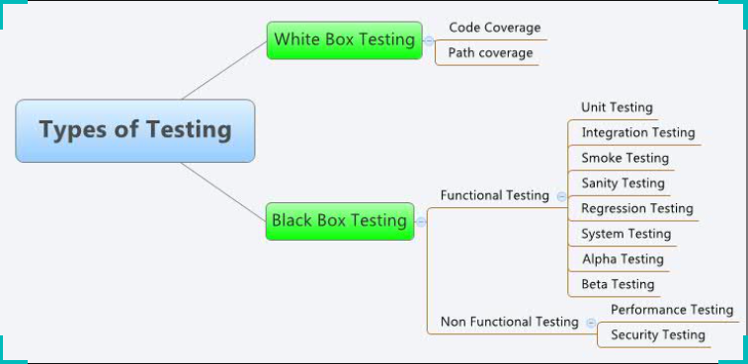
Types of Testing

Slide 8
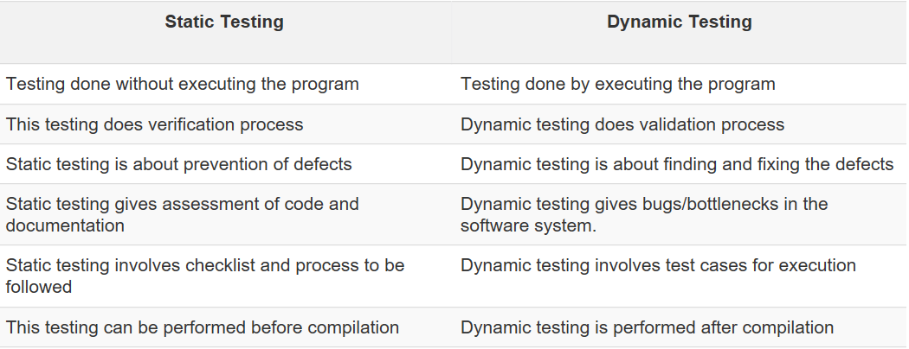
Types of Testing

Slide 9
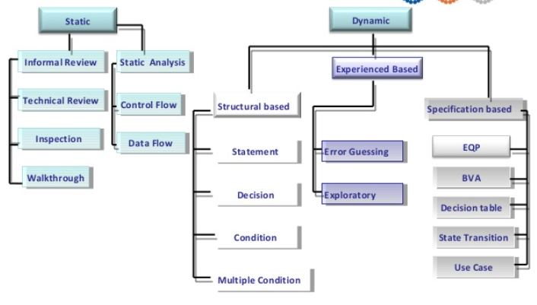
Types of Testing
Work document can be of following:
a. Requirement specifications
b. Design document
c. Source Code
d. Test Plans
e. Test Cases
f. Test Scripts
g. Help or User document..

Slide 10
THANK YOU

